Slide 1
Office of <EM, NNSA, SC)> <Project Name>
Critical Decision-1
Approve Alternative Selection & Cost Range
<ESAAB> or <PMRC> Brief
Presented by: <Name of Briefer> <Title>
<Date of Brief>

Slide 2
Briefing Outline
Purpose
Background, Mission Need & Project Scope
Proposed Siting, Site Plan Concept & Facility Concept
Alternatives Considered & Preferred Alternative
Project Organization
Preliminary CD-1 Cost, Cost Range, & CD Schedule
Preliminary Funding Profile
Risk Summary
Key Tailoring Strategies
Independent Reviews (ICR, if required)
Key Performance Parameters
CD-1 Prerequisites
PMRC Issues (If Applicable)
Recommendation
Backup

Slide 3
Purpose
Obtain AE approval of Critical Decision-1 for <project name>
Critical Decision-0, Approve Mission Need, was approved by <Name, Office Symbol>, on <Date>, with a ROM cost range of:
<$xx million to $xx million>
Project completion in <insert year>
The <Program Office name> Mission Need Statement
Describe Program Office mission and how it supports the overall program’s mission.
MNS Bumper Sticker

Slide 4
Background
<Discuss pertinent background information, if needed>
<include discussion of external and internal drivers>

Slide 5
Mission Need & Project Scope
Mission Need
<Discuss pertinent background information, if needed>
Project Scope
<include discussion of external and internal drivers>

Slide 6
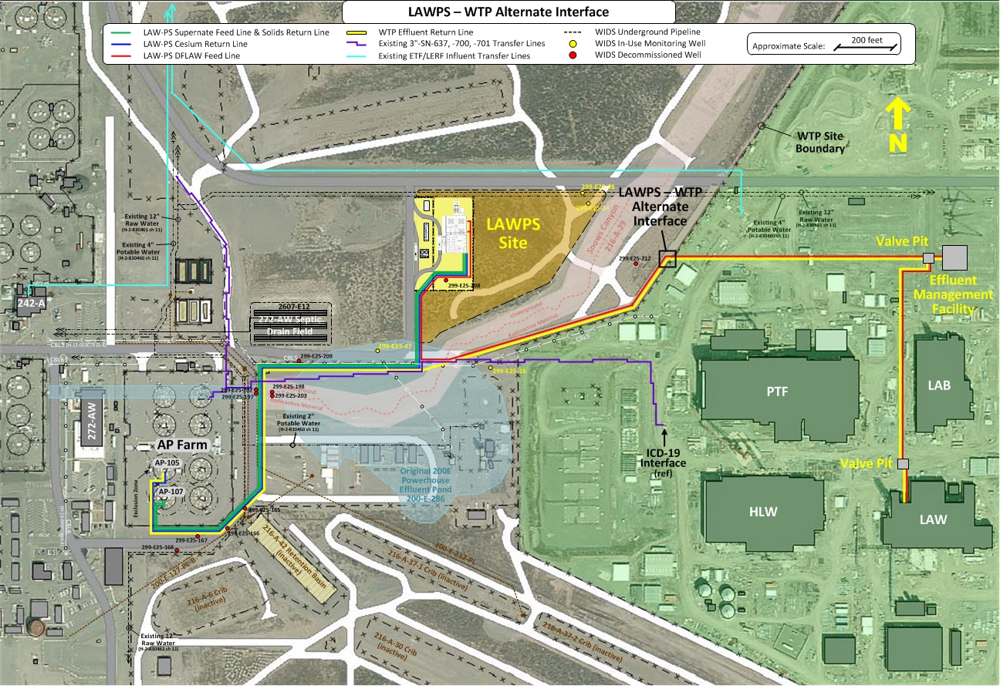
Proposed Siting
<insert graphic, as applicable>
Notional

Slide 7
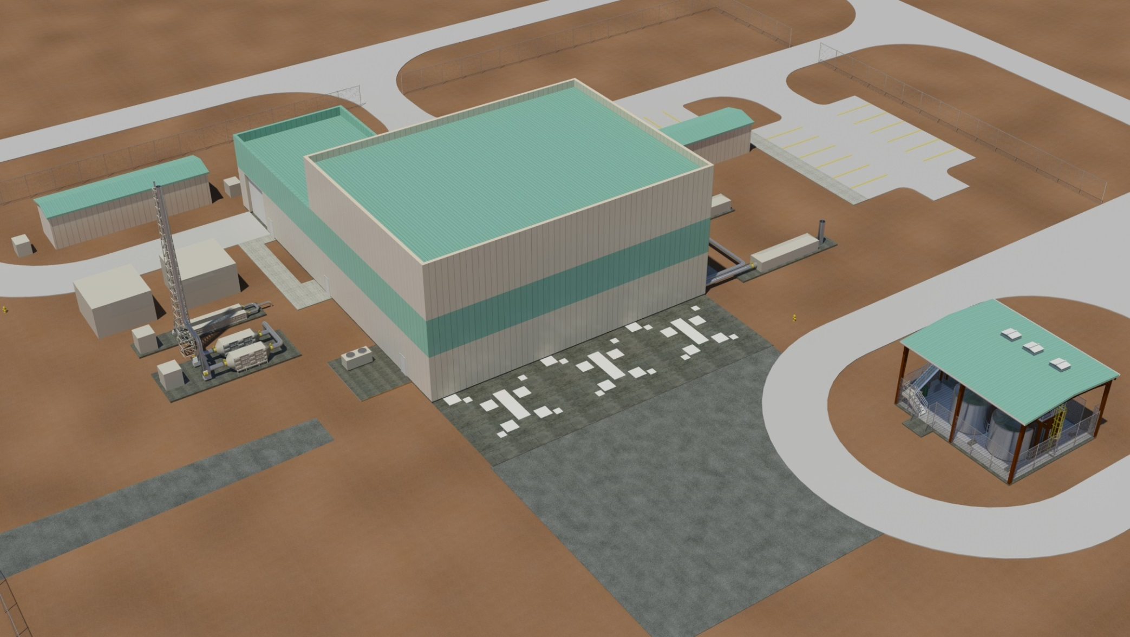
Site Plan Concept
<insert graphic, if applicable>
PROCESS COMPRESSOR
RESIN HANDLING
PERSONNEL CHANGE FACILITY
PROCESS CHILLER
PARKING
PROCESS AREA
EEC
Notional
VESSEL VENT SUPPLY
LAW LAG STORAGE
VAULT SUPPLY CHILLER
CRANE SET-UP AREA
PROCESS BLDG/VAULT EXHAUST
VESSEL VENT EXHAUST
REAGENT STORAGE

Slide 8
Facility Concept
<insert graphic, as applicable>
<insert graphic, as applicable>
Notional

Slide 9
Alternatives Considered
<Discuss Alternatives and Alternatives Analysis completed>

Slide 10
Selection Criteria Table
<Must include as a minimum: 1) Acquisition Cost and 2) Life Cycle Cost (LCC)>
Other Recommended Criteria:
Meeting Mission need
Meeting Regulatory Requirements
Timelines
Nuclear Safety (as applicable)

Slide 11
Preferred Alternative
<Discuss Preferred Alternative and selection rationale>

Slide 12
Project Organization
Deputy Secretary of Energy
(Chief Executive for Project Management)
Dr. Elizabeth Sherwood-Randall
Deputy Under Secretary for Performance and Management
Mr. David Klaus
Notional
Assistant Secretary for Environmental Management (Acting)
(Project Management Executive / Project Owner)
Mr. Mark Whitney
Headquarters
Deputy Assistant Secretary for Tank Waste
Mr. Ken Picha
ORP Site
Manager, Office of River Protection
Mr. Kevin Smith
One-System Manager, Office of River Protection
(Project Mentor)
Mr. Ben Harp
FPD Level IV
Contracting Officer
Mr. Wade Hader
CO Level 3
Federal Project Director
Mr. Steve Pfaff
FPD Level I
Integrated Project Team
Chartered
Note: Org chart should show at a minimum - PME, Owner, Respective Chain of Command and FPD

Slide 13
Preliminary CD-1 Cost & Schedule
Cost
Cost Range:
Schedule
CD-1, Approve Alternative Selection & Cost Range - <date>
CD-3A, Approve Long Lead Procurement - <date>
CD-2, Approve Performance Baseline - <date>
CD-3, Approve Start of Construction - <date>
CD-4, Approve Start of Operations - <date>

Slide 14
Preliminary Funding Profile
Funding in $ million, some rounding
Fiscal Year | 2014 | 2015 | 2016 | 2017 | 2018 | 2019 | 2020 | 2021 | Total
PED (Project Engineering & Design) |  | 23 | 70 |  |  |  |  |  | 63
Construction |  |  |  | 67 | 83 | 63 | 14 | 4 | 301
OPC | 5 |  | 5 | 20 | 1 | 1 | 15 | 4 | 50
Total: | 5 | 23 | 75 | 87 | 84 | 64 | 29 | 8 | 374
Comments on funding profile…
…
…

Slide 15
Major Risk Summary
Description | Impact Level | Mitigating Actions
Technology Readiness Level insufficient for CD-2 approval | High | Identify integrated test objectives for each critical technology element to ensure testing is scalable for full size operations and produces best possible design.
Technology Readiness Level insufficient for scheduled start of hot commissioning | High | Plan for integrated full-scale test as part of equipment procurement prior to assembly at the LAWPS construction site.
Environmental permits delayed | High | Continue close integration with Washington State Departments of Ecology and Health to develop permitting activity schedules.
Failed startup test | Medium | Off-site integrated testing at full scale to ensure operability prior to system installation.
Design-affecting requirements change during LAWPS design | Medium | Incorporate updated DOE O 420.1C, DOE-STD-3009-2014, and other applicable updated standards at beginning of preliminary design phase. Freeze code of record at CD-2.
WTP not in alignment with LAWPS | Medium | Continue active participation in One System organization to ensure DFLAW program elements are understood and agreed upon during development.
sRF resin in not available when needed | Medium | Develop supply agreement with sole source supplier and acquire long-term inventory of resin seed stock and beads.
Craft resources availability | Medium | Incorporate resource analysis and hiring processes into field execution schedule.
Equipment damage during construction or startup testing or storage | Medium | Develop critical item list and determine handling requirements to protect equipment and personnel during installation.
Preliminary Documented Safety Analysis approval delayed | Medium | Continue close coordination within DOE and with DNFSB during safety basis development according to latest approved standards during design.
Critical Decision (CD-2, 3A, 3) approvals delayed | Medium | Continue close coordination within DOE to conduct timely project reviews and approval steps.

Slide 16
Key Tailoring Strategies
Per the Preliminary Project Execution Plan (P-PEP):
….
….
….

Slide 17
Independent Reviews
Independent Alternative Analysis (discuss independent review results of alternatives)
…
…
…
DO APM Independent Cost Estimate Results (if applicable)
Final Report Completed: <date>
Cost Range Recommended: <insert range here>
<if project team recommending a cost range that differs from DOE APM cost range, provide statement here explaining rationale>

Slide 18
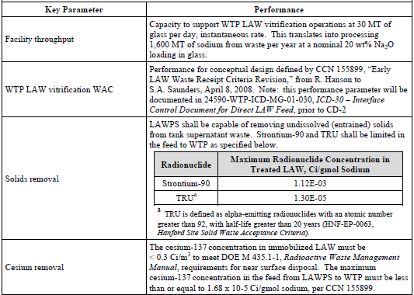
Preliminary Key Performance Parameters (PPEP rev. <X>)

Slide 19
Scope of Work
<Discuss Preliminary “Scope of Work”>

Slide 20
CD-1 Prerequisites
DOE O 413.3B
CD-0 Approved
Mission Need Statement
✓ Conceptual Design Report Issued
☑ Acquisition Strategy Approved (submit with CD-1 package)
☑ Preliminary Project Execution Plan (submit with CD-1 package)
☑ Tailoring Strategy (Included in PPEP, submit with CD-1 package)
☑ Federal Project Director appointed (submit with CD-1 package)
✓ Integrated Project Team Chartered
✓ Independent Project & Design Review completed
Project Data Sheet completed/updated
☑ Independent Cost Estimate completed (pending)
✓ NEPA Environmental Assessment completed
Integrated Safety Management Plan implemented
✓ Safety Design Strategy (nuclear facilities) developed
✓ Preliminary Hazardous Analysis Report approved
Quality Assurance Plan established
Risk Management Plan completed
Conceptual Safety Design Report prepared
Conceptual Safety Validation report prepared
One-for-One Replacement compliance

Slide 21
PMRC Issues
<Identify those significant issues (as appropriate) that the PMRC should be made aware of>

Slide 22
Recommendation
Recommendation:
Approve CD-1, Alternative Selection and Cost Range for <project name>
Selected Alternative:
Cost Range:

Slide 23
Back-Up Material as Needed

